Slide 1
Azure Training Day Migrating .NET applications to Azure

Slide 2

Presentation title
Let’s get Started!
Tell us what you think by completing our survey
Schedule a post-event session to address your specific requirements.
Speaker name
Title
Learn more : aka.ms/techdocs
Get certified : aka.ms/microsoftlearn
Sign up Developer newsletter: aka.ms/usdevconnect

Slide 3


About Me…
Peter De Tender – MCT, Azure MVP
CEO and Lead Technical Trainer of 007FFFLearning.com, +20 years IT experience, mainly datacenters and Microsoft Infrastructure background
Full-time in Azure since 2013 (Readiness & Architect)
Azure Advisor, Azure Certified Architect
Technical Writer, Book author, Courseware Creator
Living in Belgium, but traveling worldwide 90% of my time, helping larger Microsoft Partners, customers and Microsoft FTEs in learning about and using Azure, by providing workshops with passion
peter@pdtit.be
@pdtit @007FFFLearning
http://www.facebook.com/pdtit
http://www.linkedin.com/in/pdtit

Slide 4
Workshop delivery
For the technical trainers:
Each Module could be presented as a stand-alone module, although the full potential comes from delivering all modules
HOL are somehow depending on each other, starting from the IAC-lab, where students deploy the VM-based source environment, moving to WebApps, SQL PaaS, Docker, Azure Container Registry, running Azure Container Instance, and ultimately Azure Container Services with Kubernetes. (only labs that could be skipped are WebApps and AKS)
The HOL solution is based on a ASP.NET Core app « SimplCommerce » (Open Source), using SQL Database

Slide 5
Workshop delivery
For the technical trainers:
Whenever you detect any mistakes, issues, wrong wordings,… in presentations or LAB guides, please send an email to :
msdevseriessupport@007FFFLearning.com, subject « Azure Developer Series – Containers », so we can take care of this and fixing it immediately
Latest version of all content should be available on GitHub:
http://www.github.com/007FFFLearning/MSDevSeriesSupport

Slide 6
.NET Application Migration
SQL Azure – Migrating databases to Azure PaaS
Peter De Tender
@pdtit @007FFFlearning

Slide 7
Key Objectives
What you will learn in this section
Why migrating databases to Azure
What is SQL Azure
Migration Strategies for SQL workloads
Optimizing and Securing SQL Azure

Slide 8

Note regarding Demos
The demo slides are mainly used as a placeholder for in-person delivery of this workshop.
If you are watching this as a recorded session, know the demos are snippets from the full lab exercise related to this workshop module, and not fully-orchestrated demo scenarios.

Slide 9
SQL Azure: Introduction

Slide 10


SQL Data Platform: Roadmap
On-Premises
Public Cloud
Shared / Lower OPS Cost
SQL Azure Hosted Databases
Virtual Machines in Public Cloud
Virtualized SQL Servers
Physical SQL Servers Bare-Metal
Dedicated / High OPS Cost
Complex Administration
Easier Administration

Slide 11
SQL IaaS Options
SQL VM (IaaS)
A flavor of SQL Virtual Machines, running Windows or Linux OS, leveraging on all Azure IAAS features
$
Virtual Machines
Cost Optimized
BCDR
Easy lift and shift
Fully managed IaaS
Full isolation and security
High Availability
Migrate your physical or virtualized VMs to Azure as-is
Built on the Azure IaaS service offering full infrastructure
All IaaS features
Native VNET implementation
Private IP addresses
Azure AVSet / ScaleSet
SQL AlwaysOn Replication

Slide 12
SQL PaaS Options
SQL Database (PaaS)
A flavor of SQL DB designed to enable easy migration to fully managed PaaS, for almost any application!
Managed Instance
SQL Azure
Elastic Pools
Easy lift and shift
Fully managed PaaS
Full isolation and security
New business model
Fully-fledged SQL instance with nearly 100% compat with on-prem
Built on the same PaaS service infrastructure
All PaaS features
Native VNET implementation
Private IP addresses
Competitive
Transparent
Frictionless

Slide 13





Removing security & isolation concerns (IaaS)
Web app
(public IP)
VNet-to-VNet
VNet1
SQL Instance #1
SQL Instance #2
Network isolation (customer VNET)
SQL Instance #3
Tenant isolation
(compute, storage)
“Virtual cluster” dedicated to customer
(VNET with chosen subnets, private IPs)
VPN / Express Route Gateway
VPN tunnel or provider network
оn-premises

Slide 14

Removing security & isolation concerns (PaaS)
Web app
(public IP)
VNet-to-VNet
VNet1
SQL Instance #1
SQL Instance #2
Network isolation (customer VNET)
SQL Instance #3
Tenant isolation
(compute, storage)
“Virtual cluster” dedicated to customer
(VNET with chosen subnets, private IPs)
VPN / Express Route Gateway
VPN tunnel or provider network
оn-premises

Slide 15


Integrate High Availability / Disaster Recovery (SQL IaaS)
Web app
(public IP)
Azure Region 1
VNet-to-VNet
VNet1
VNet1
SQL Instance #1
SQL Instance #2
SQL Instance #3
“Multi-Region” replication and failover
Network isolation (customer VNET)
SQL Instance #1
SQL Instance #2
Tenant isolation
(compute, storage)
SQL Instance #3
VPN / Express Route Gateway
VPN tunnel or provider network
оn-premises
Azure Region 2

Slide 16
Integrate High Availability / Disaster Recovery (SQL PaaS)
Web app
(public IP)
Azure Region 1
VNet-to-VNet
VNet1
VNet1
SQL Instance #1
SQL Instance #2
SQL Instance #3
“Multi-Region” replication and failover
Network isolation (customer VNET)
SQL Instance #1
SQL Instance #2
Tenant isolation
(compute, storage)
SQL Instance #3
VPN / Express Route Gateway
VPN tunnel or provider network
оn-premises
Azure Region 2

Slide 17
Azure SQL Database deployment

Slide 18
Demo
Deploying SQL Azure

Slide 19
Azure SQL Features…
Security
Active Geo-Replicas
Performance Insight
Automated Tuning
Adaptive Query Processing
Azure Data Sync

Slide 20
SQL PaaS Security Enhancements
Firewall
Secure Connections
Data In Flight
Data At Rest
Audit
Threat Detection

Slide 21
Demo
Deploying Azure SQL main feature highlights

Slide 22
Azure Database for SQL – Data Migration

Slide 23
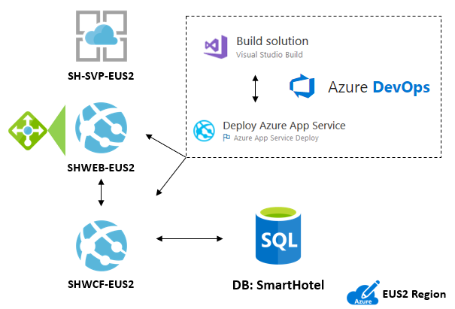
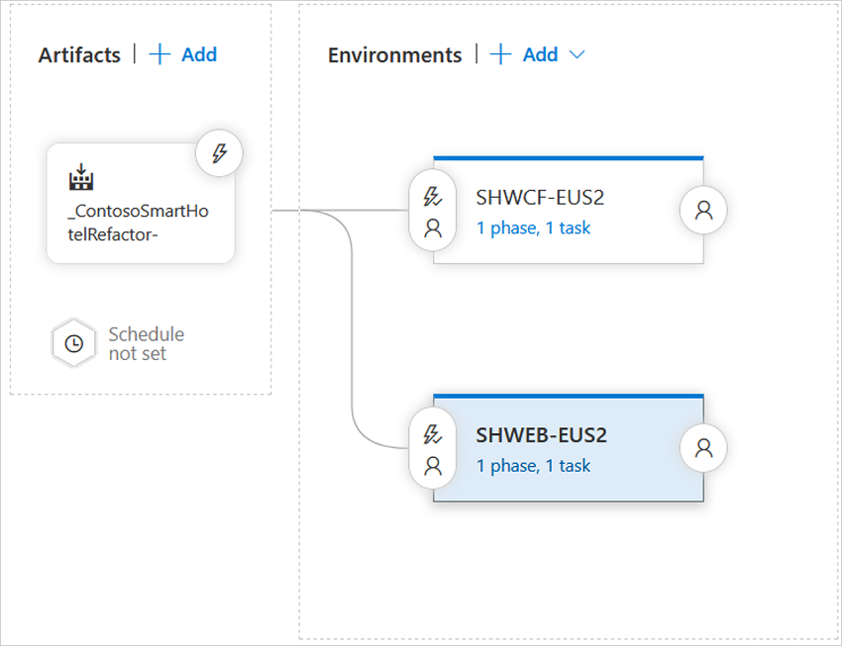
Refactor an on-premises app to an Azure Web App and Azure SQL database – Reference Architecture
Web App and Service deployed to Azure App Services
Database deployed to Azure SQL DB
Solution is Built & Deployed using Azure DevOps Pipelines

Slide 24
Opportunity - Windows Server/SQL Server 2008/R2 EOS
Migrate to Azure
Free Extended Security Updates 2008/R2 versions 3 years past EOS deadline
Extended support
Ends July 9, 2019
SQL Server 2008 and 2008 R2
Extended support
Ends January 14, 2020
Windows Server 2008 and 2008 R2
Upgrade
Move to current Windows Server/SQL Server versions
2018
2019
2020
*Customers can also buy 3 more years of Extended Security Updates on 2008/R2 for on-premises use @ 0.75L pricing

Slide 25
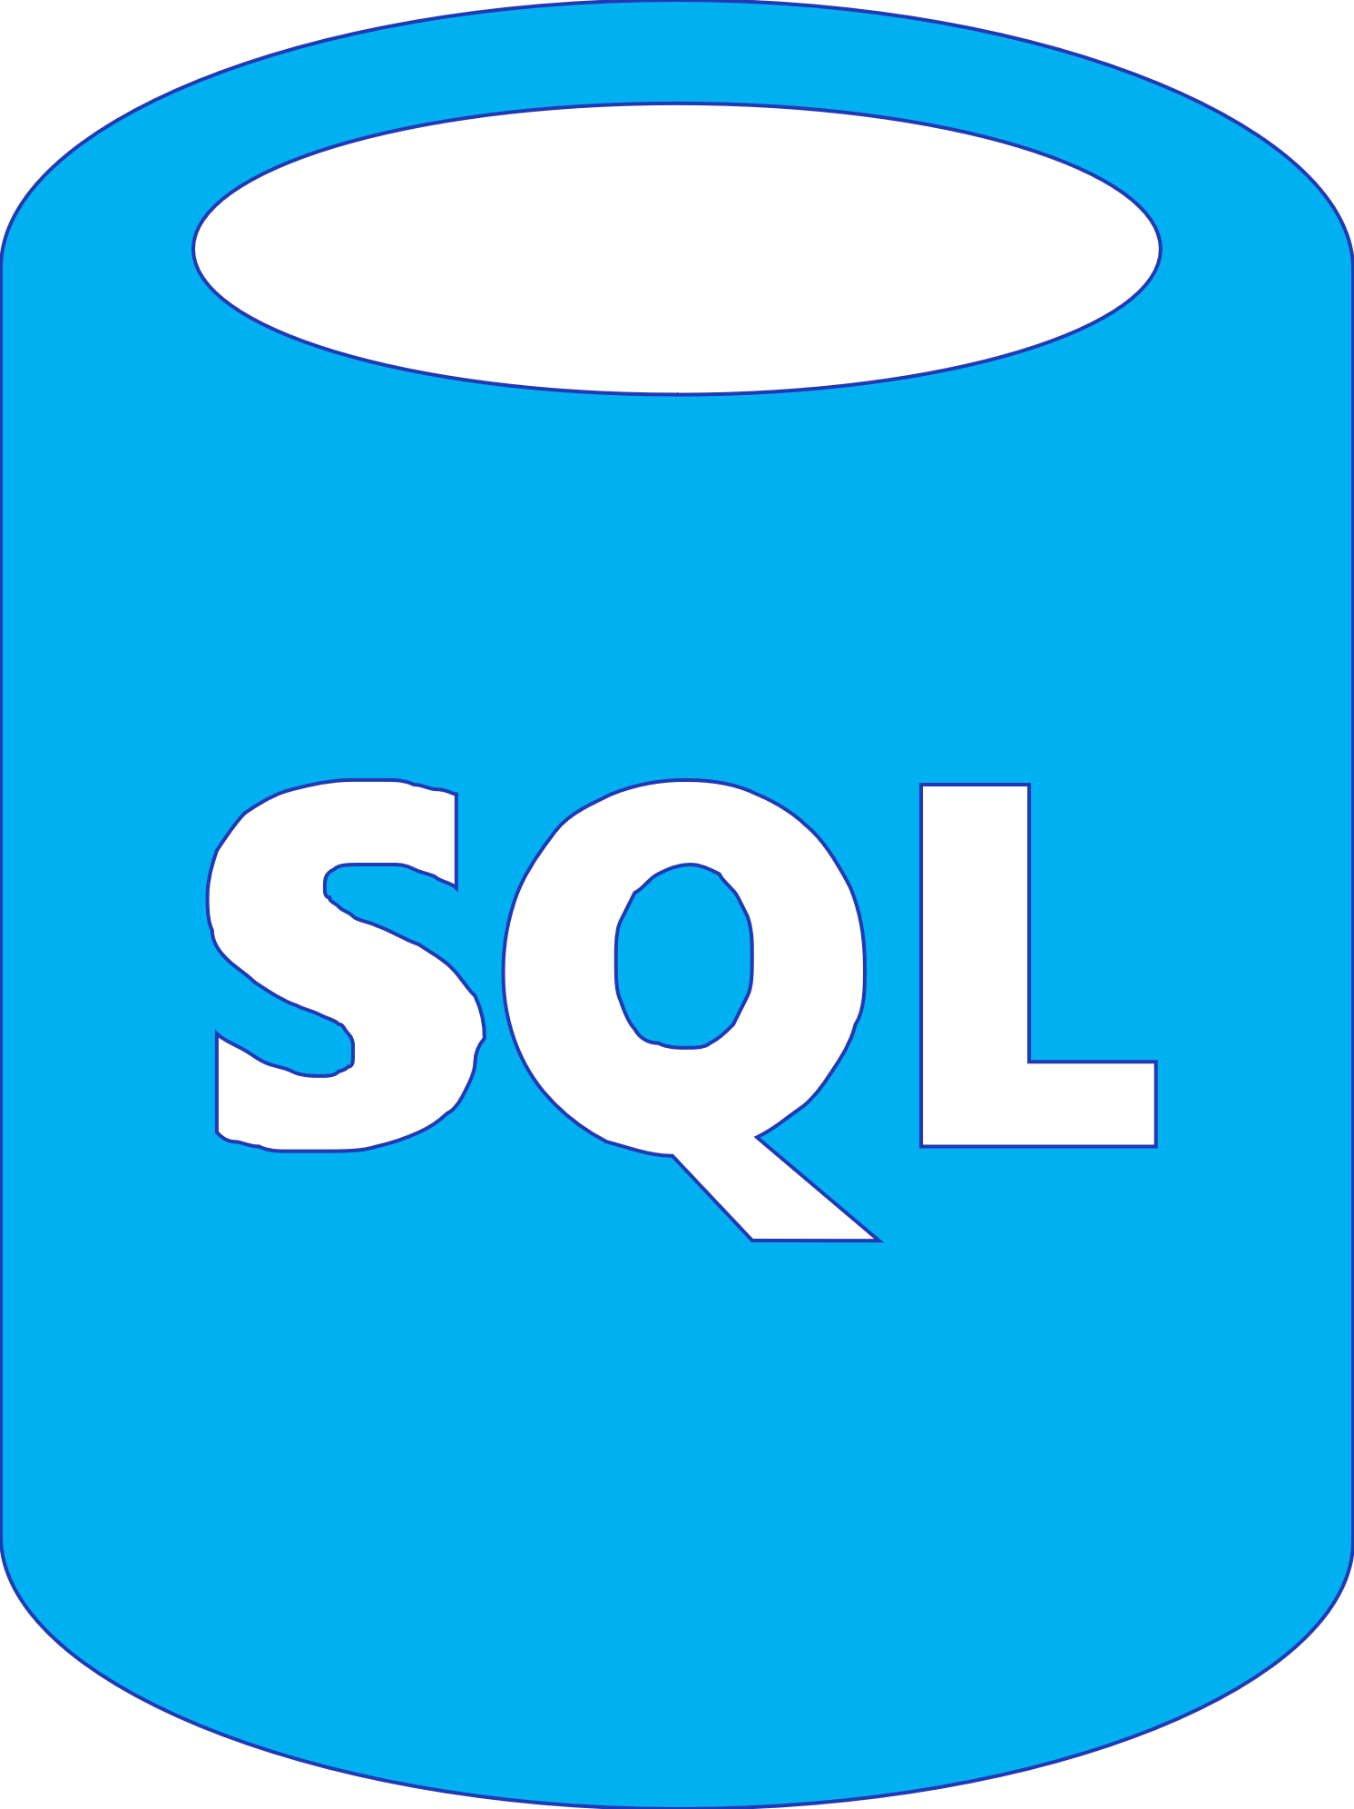
ASP.NET Application Migration to Azure PaaS
On-premises
Azure
Vmware / Hyper-V / Physical
LOB App
App Service
Migration Assistant
LOB App
App layer
Azure App Service
App layer
Windows Server
Data layer
Azure SQL Database Managed Instance
Data layer
SQL Server
Azure Database Migration Service

Slide 26
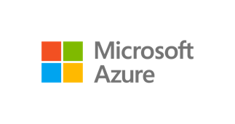
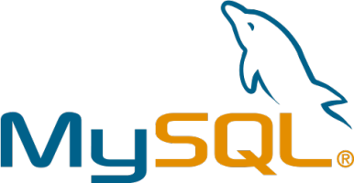
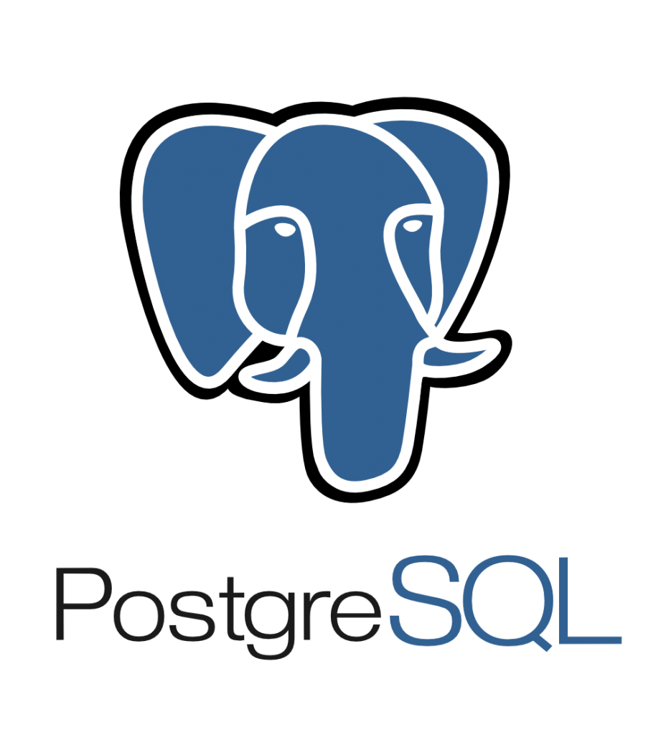

Migrate databases using Azure Database Migration Service
On-premises
SQL Server 2005 - 2017
My
Assessment
SSMA & DMA
Azure Database Migration Service
Cosmos DB
Seamless, end to end solution | Near-zero downtime | Migrate at-scale from multiple sources
Notes:
As organizations look to optimize their IT infrastructure to have more time and resources to focus on business transformation, Microsoft is committed to accelerating these initiatives. The new Azure Database Migration Service (DMS) is a fully managed, first party Azure service that enables seamless and frictionless migrations from heterogeneous database sources to Azure Database platforms with minimal downtime. This service will streamline the tasks required to move existing competitive and SQL Server databases to Azure.

Slide 27
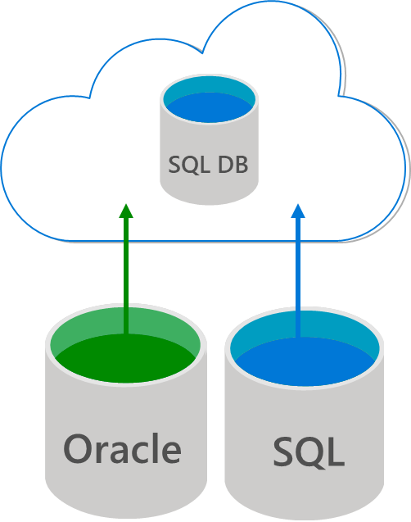
Reliable and seamless migrations with Azure DMS (Database Migration Services)
Fully managed database migration service for both operational databases and data warehouses
Supports minimal down time migrations
Supports both homogeneous and heterogeneous source-target pairs
Initial focus on reliability and performance
Iterative addition of source-target pairs
Continued investment in friction-free competitive conversions

Slide 28





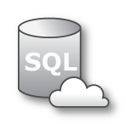


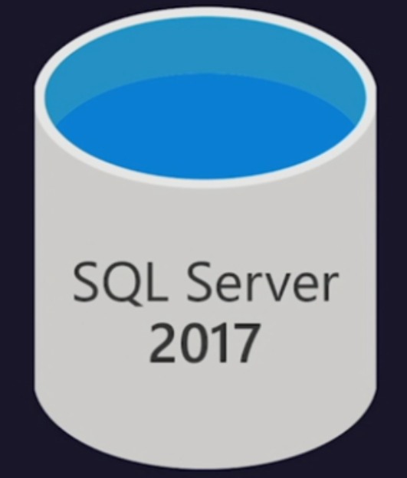


SQL Server to SQL DB Managed Instance online migration workflow
Legend
Virtual Network ( VNET )
Full Database backup files
Subnet used for MI
Transaction log backup files
Site to site connectivity (VPN or ExpressRoute)
4
Azure Blob Storage
2
1
Provide existing backups in network share
Cloud network
SQL DB
Managed Instance
Subnet used for DMS
2
DMS upload backup files to Azure storage
3
3
DMS initiate the migration to Azure SQL MI
4
Full backup restored and Transaction log
backups continuously applied until cutover
1
SMB Network Share
Provide Tail-Log backup, initiate cutover in DMS and change the application connection strings
On-Premise

Slide 29
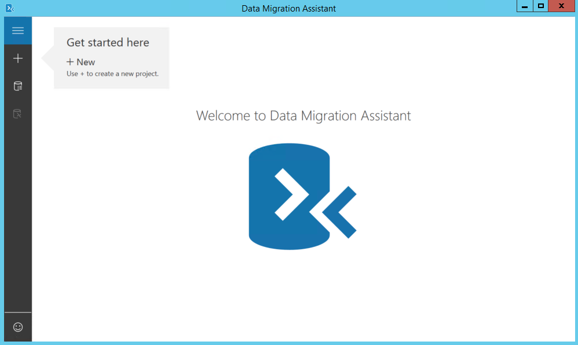
SQL Data Migration Assistant
You can likely migrate some apps to Azure SQL Database, without any changes, already today…
Start migrating now:
Download and run Data Migration Assistant
Automated assessment will identify databases that are safe to move, w/o changes

Slide 30
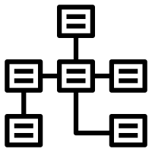


Migrating Your Data To Azure SQL Database
+
=
+
Schema
Data
Migration

Slide 31
Demo
Migrating SQL Server using Database Migration Assistant

Slide 32
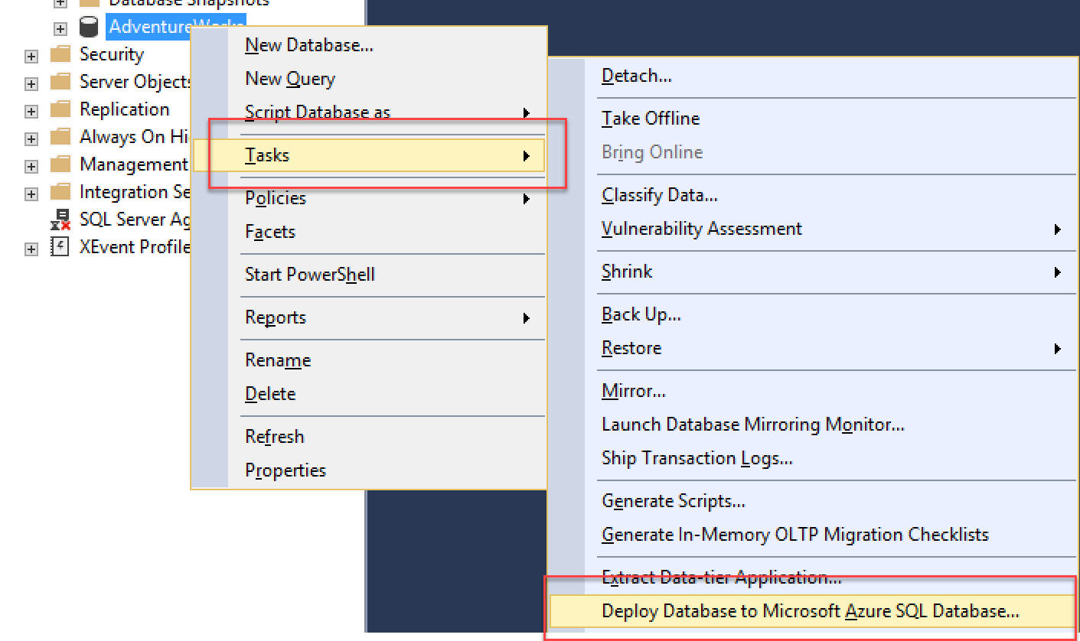
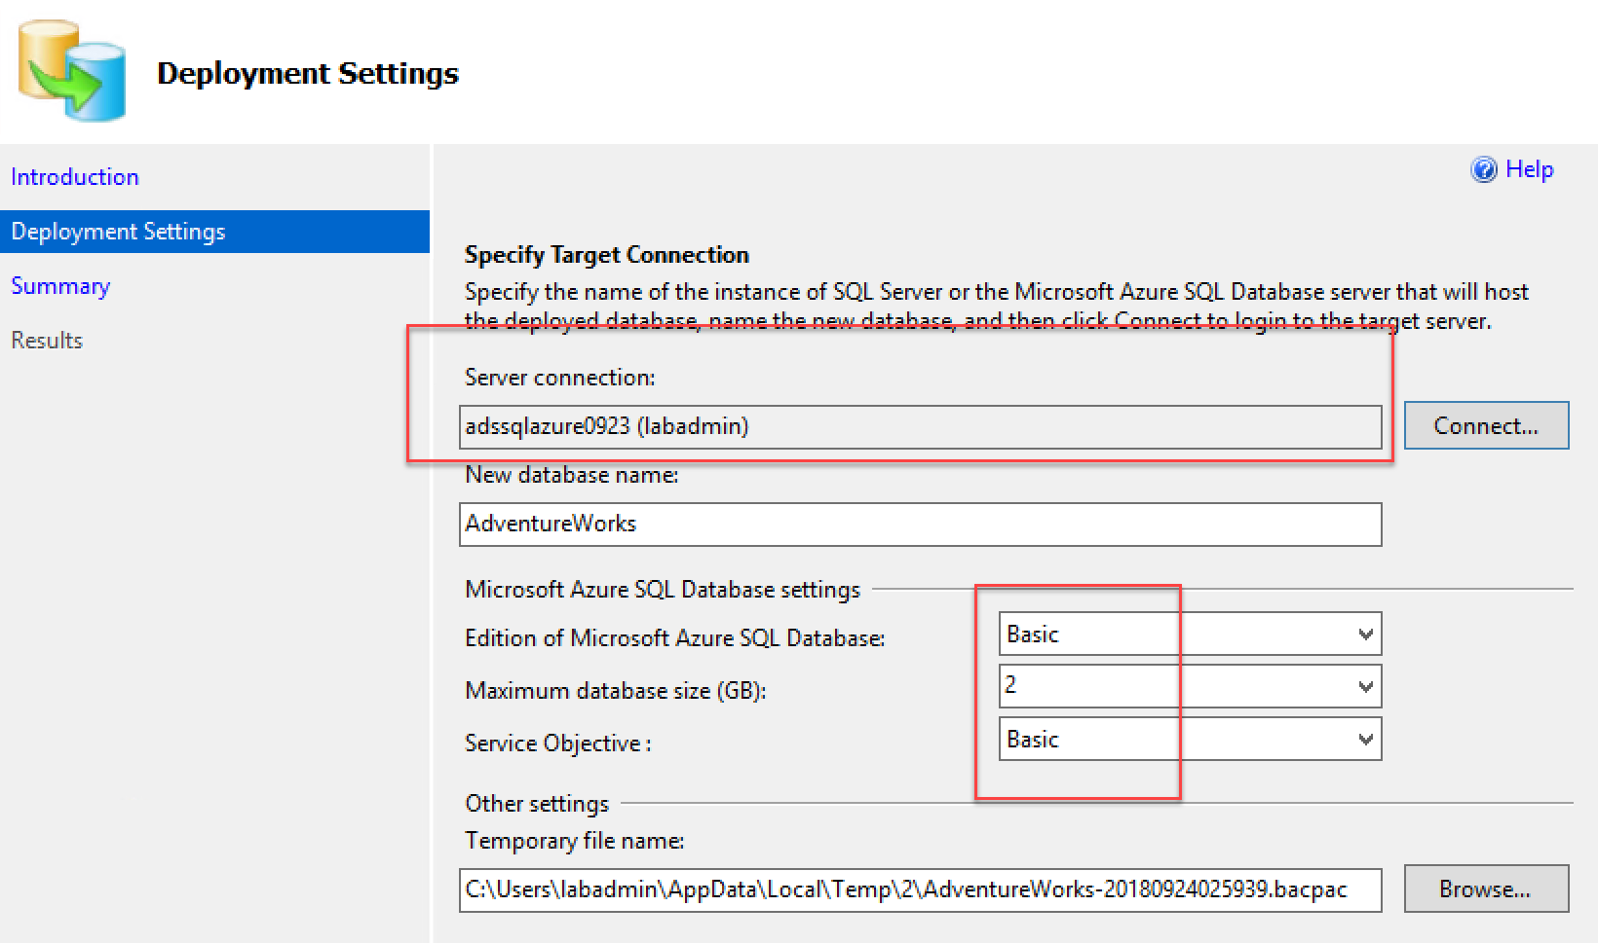
SQL Data Migration From SQL Management Studio
If your source database is fully compatible with SQL Azure, just migrate…
Start migrating now:
From MSSMS, connect to both database endpoints
Live migrate to SQL Azure

Slide 33
Demo
Migrating using SQL Server Mgmt Studio

Slide 34
Easy migration: nearly 100% like SQL Server
Data migration
Native backup/restore
Log shipping (DMS)
Security
TDE
SQL Audit
Row level security
Always Encrypted
Programmability
Global temp tables
Cross-database queries and transactions
Linked servers
CLR modules
Operational
DMVs & XEvents
Query Store
SQL Agent
DB Mail (external SMTP)
Scenario enablers
Service Broker
Change Data Capture
Transactional Repl

Slide 35
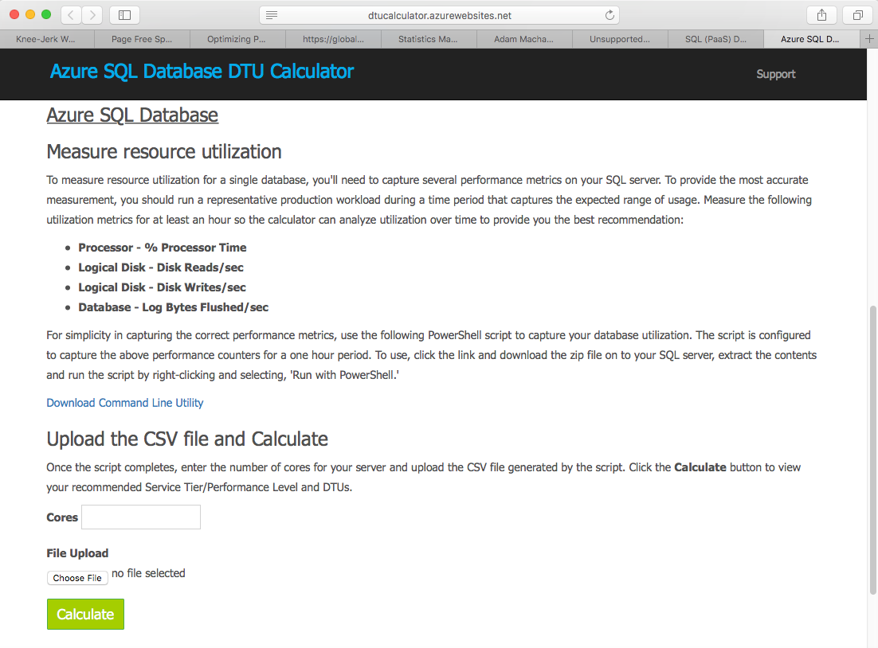
Start from a correct sizing for Azure SQL (DTU Calculator)

Slide 36
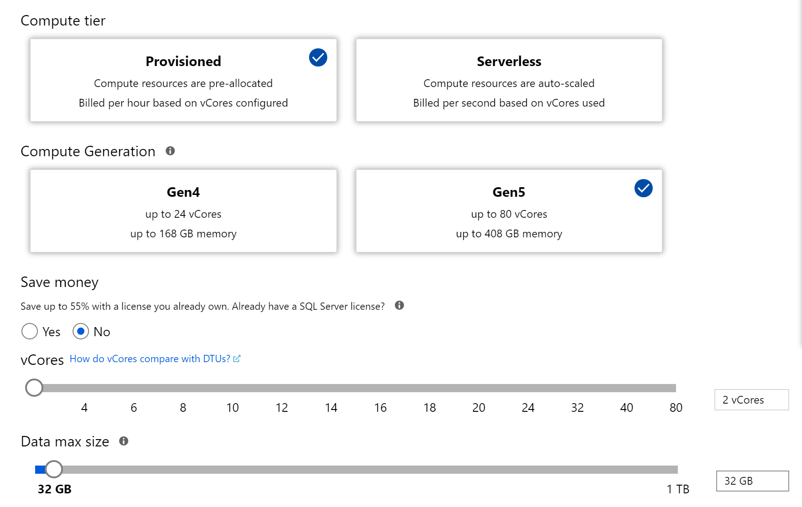
Start from a correct sizing for Azure SQL (vCore Model)
Managed Instance does NOT support DTU for sizing, but uses the vCore model

Slide 37
Options to Move Your Data…
BACKPAC
Transactional Replication

Slide 38
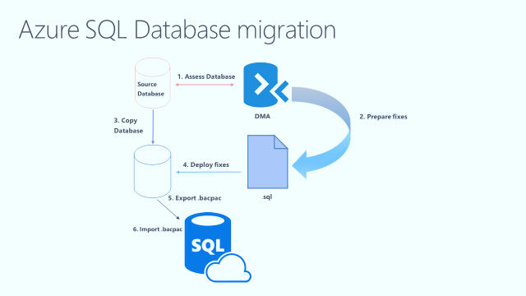
Migrations to Azure SQL Database
https://azure.microsoft.com/en-us/documentation/articles/sql-database-cloud-migrate/

Slide 39
Demo
Import SQL Databases from BacPac file

Slide 40
Easy Guide to Quickly Migrating Data
Increase Tier
Copy Data
Reduce Tier

Slide 41
Easy migration – Other SQL Components: SSIS / SSAS / SSRS
Will not be installed side-by-side with SQL Managed Instance!!
Recommendation:
move to PaaS model
Migrate your SSIS packages to new SSIS on Azure Data Factory (PaaS service)
Migrate your OLAP models to Azure Analysis Services
… or run these services in Azure virtual machines
For SSRS: run in a virtual machine, or switch to Power BI

Slide 42
Integration Runtime for SSIS
Managed Cloud Environment
Pick number of nodes & node size, resize later if needed
Compatible
Same SSIS runtime across Windows, Linux, Azure Cloud
SSIS + SQL Server
SQL DB Managed instance + SSIS in cloud
Access on premises data via VNet
Get Started
Hourly pricing (no SQL Server license required)
Use existing license (coming soon)
SSIS Project
Azure
Integration
Runtime

Slide 43
Section Take-Aways
Azure offers different SQL flavors, both in IaaS and PaaS
Recommendation to move to SQL Azure (PaaS), or SQL Azure Managed Instance (PaaS)
SQL Data can be migrated in several ways, depending on source and target environment and requirements

Slide 44
Questions
Landing
Spot
“…If you want good answers, ask better questions…”
© Randy Glasbergen

Slide 45
Next Module…
Azure App Services (WebApps)
@pdtit @007FFFlearning

Slide 46
Thank You

